Slide 1
Web Programming 1
Tutorial - GitHub and VS Code

Slide 2
Install Git for Windows
https://git-scm.com/download/win
Git is a free and open source distributed version control system designed to handle everything from small to very large projects with speed and efficiency.
Install on your own machine

Slide 3
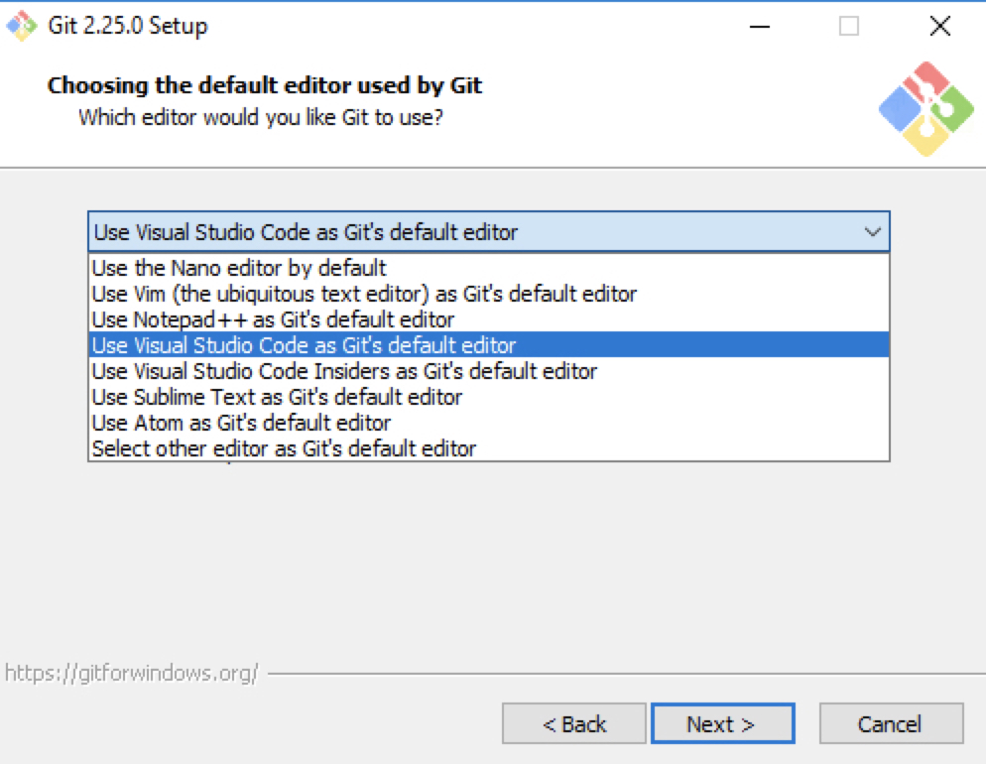
Choose these option when installing

Slide 4
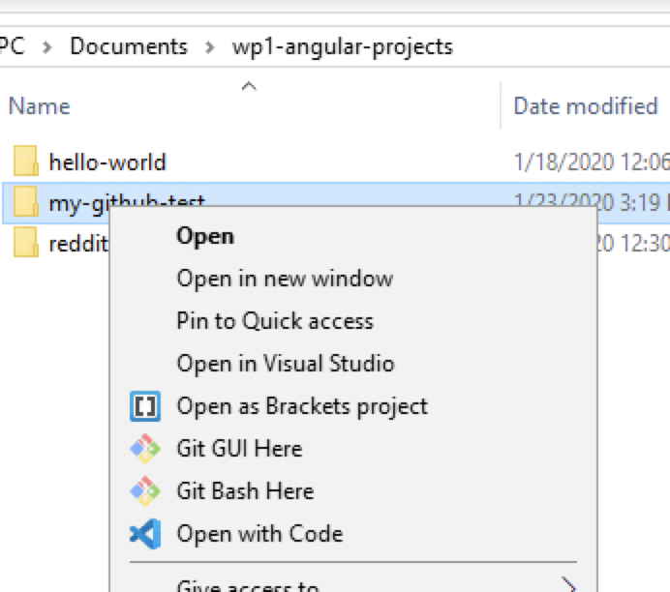
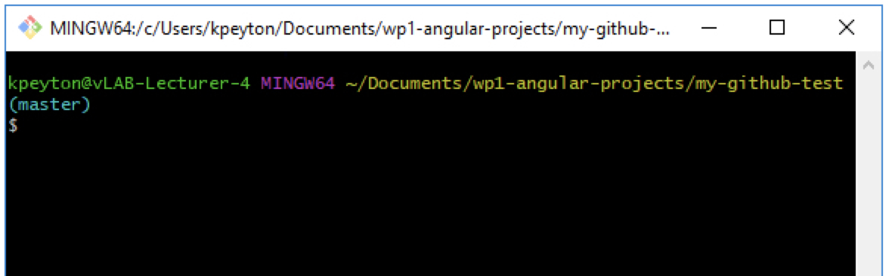
Using Git Bash
You will use Git Bash – like command prompt but for Git..
Right-click in a project folder to access

Slide 5
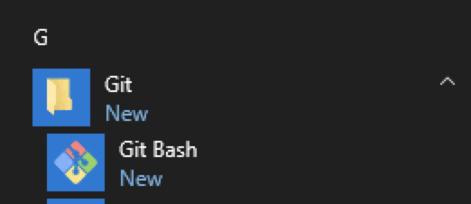
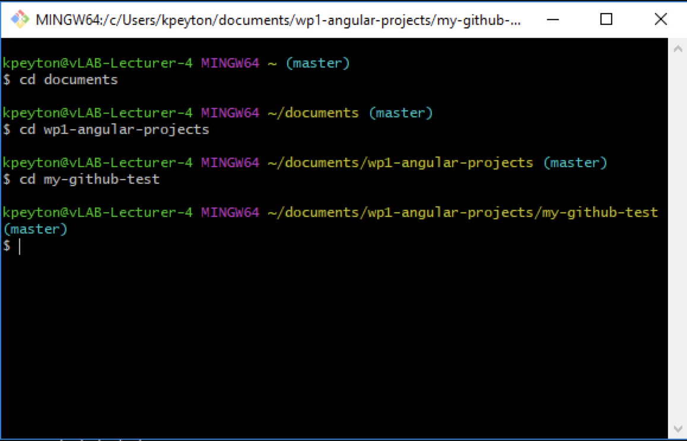
Otherwise…
Open up Git Bash window
Change directory to your my-github-test directory

Slide 6
Create a GitHub Account
GitHub is a cloud based repository based on git.
https://education.github.com/pack
Scroll to GitHub, sign up using your ITSligo Email Address
This will give you Private Repositories

Slide 7
Exercise
You are going to create a new Angular test application and store it on GitHub
Goto your angular projects directory on your VM
Create a project called “my-github-test”
ng new my-github-test

Slide 8
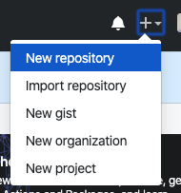
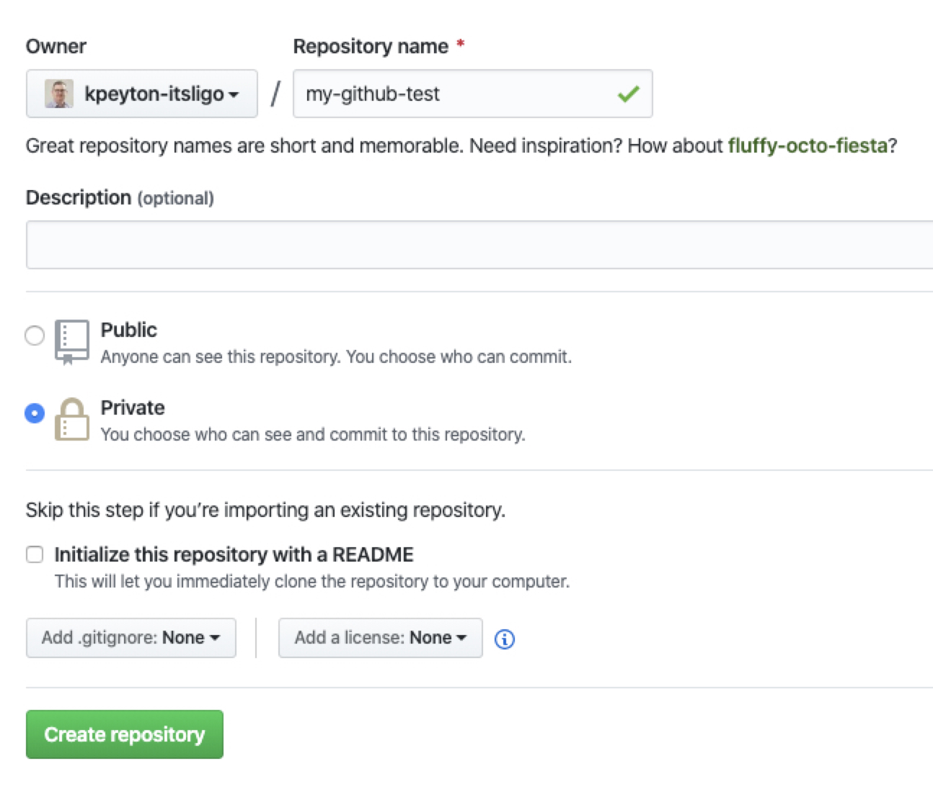
New GitHub repository
Log on to GitHub and create a new repository called my-github-test
Make it private

Slide 9
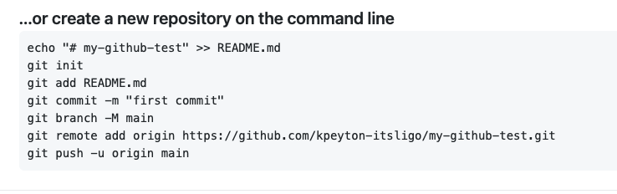
Linking Your Project and GitHub
From GitHub copy the commands below
You will not this list of commands
If you initialise repo with readme.md
Any errors relating to not being able to read from remote repository – likely relate to github login
use : git remote set-url origin https://github.com/<user_name>/<repo_name>.git

Slide 10
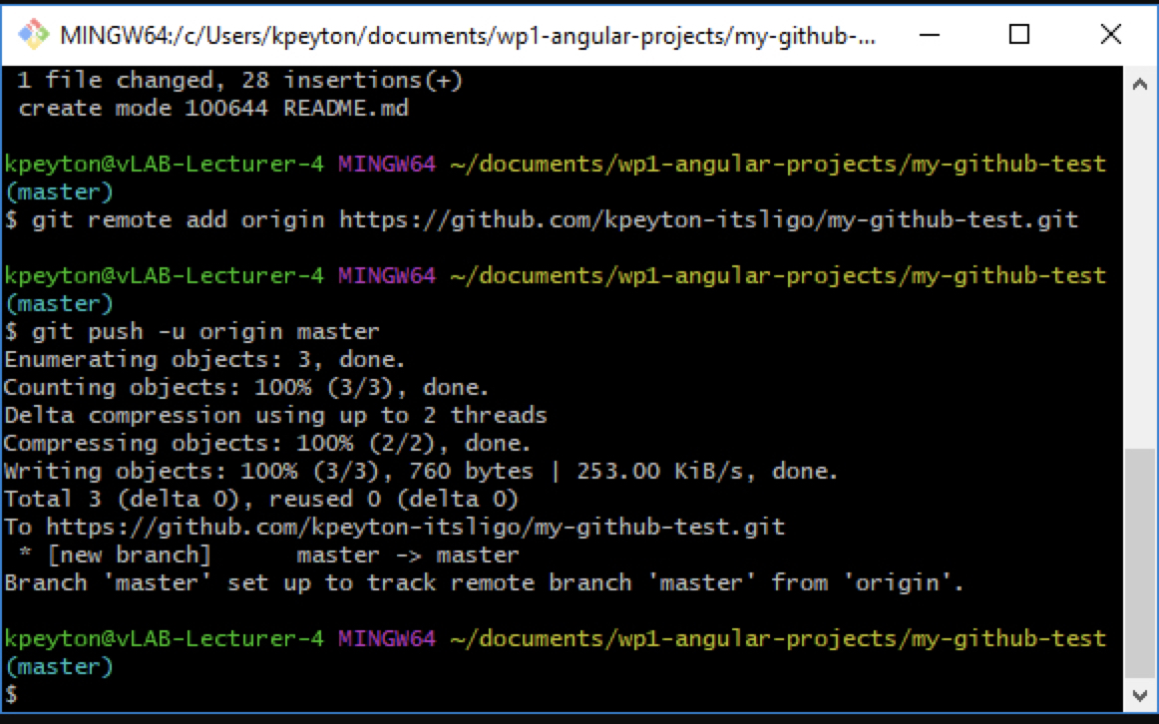
Paste these GitHub commands into your
Git Bash window..
…Now go back to your github and refresh your ”my-github-test” respository page
‘master’ is mentioned here an in future slides – should be main

Slide 11
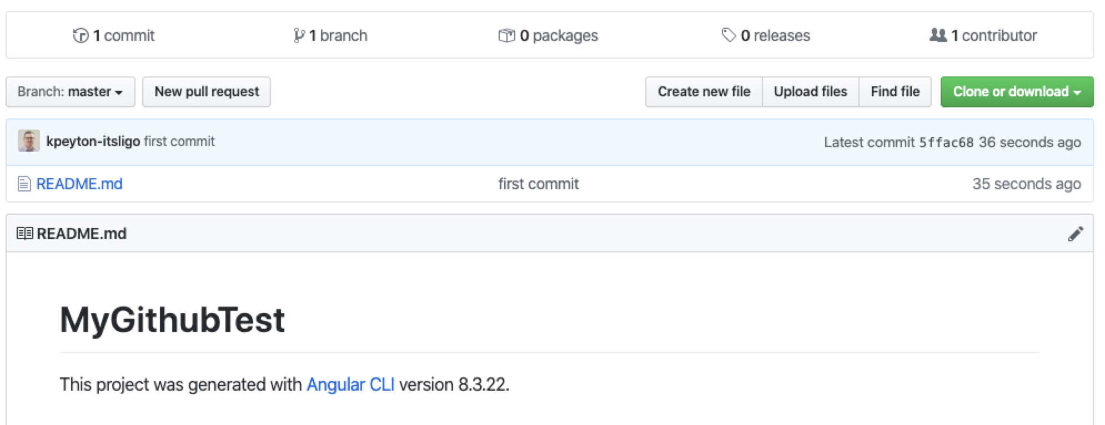
Only 1 file added to repo – this is correct…

Slide 12
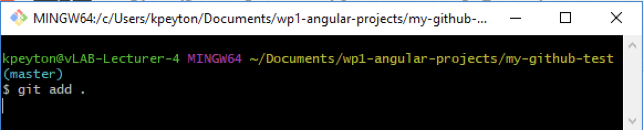
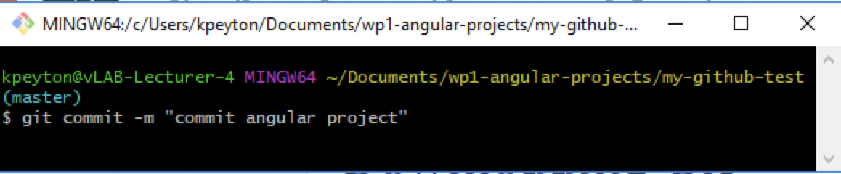
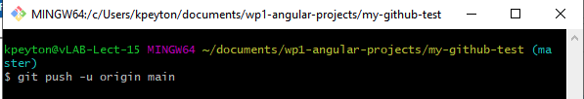
Now we need to run the following commands
Add all the files from
the current directory
This is a comment for your commit –
it relates to the changes you have made
Uploads our local repository to
Remote repository

Slide 13
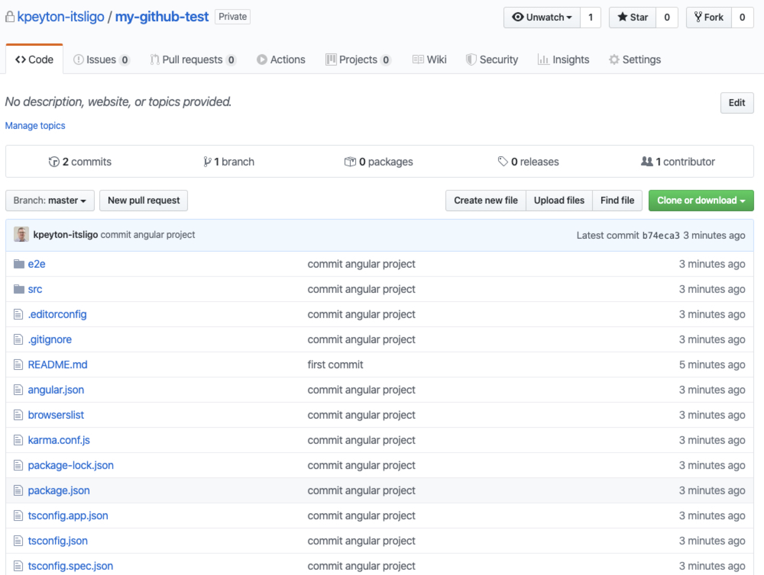
Now we see all project files have been added

Slide 14
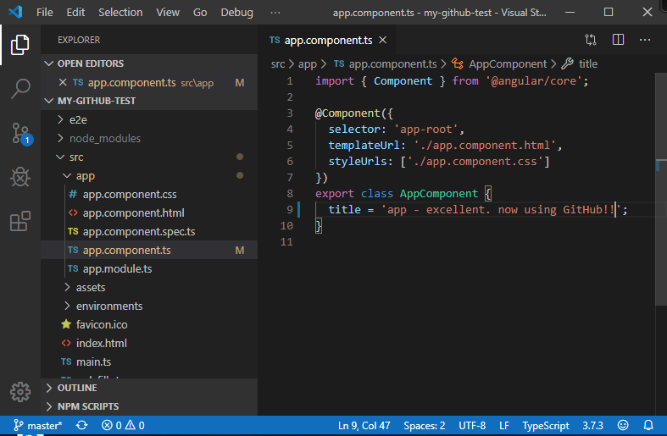
Make a code change..
When we change the title and save - the
source control glyph lights up..

Slide 15
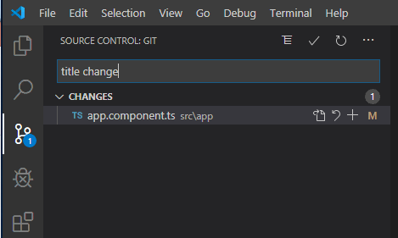
Commit Changes Locally
Add a commit message –e.g. ‘title change’
Select the tick to commit changes locally

Slide 16
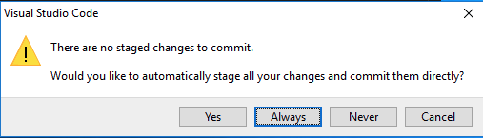
Select ’Always’

Slide 17
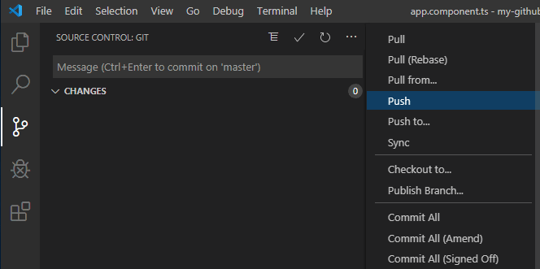
Push Changes to GitHub
First select the overflow menu (3 dots)
Then choose Push

Slide 18
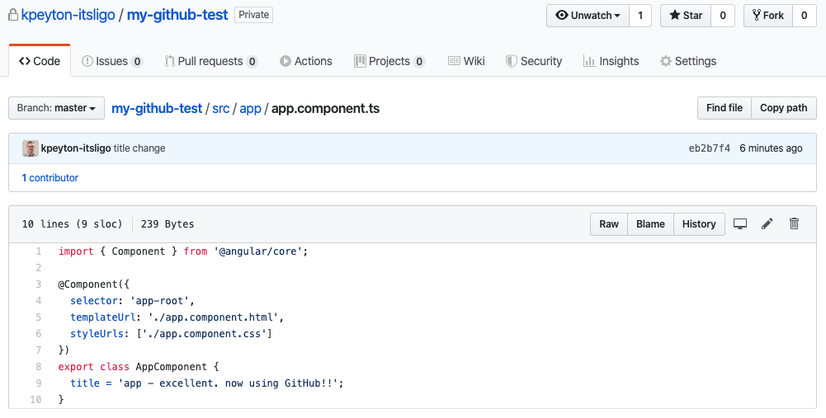
Code updated on GitHub

Slide 19
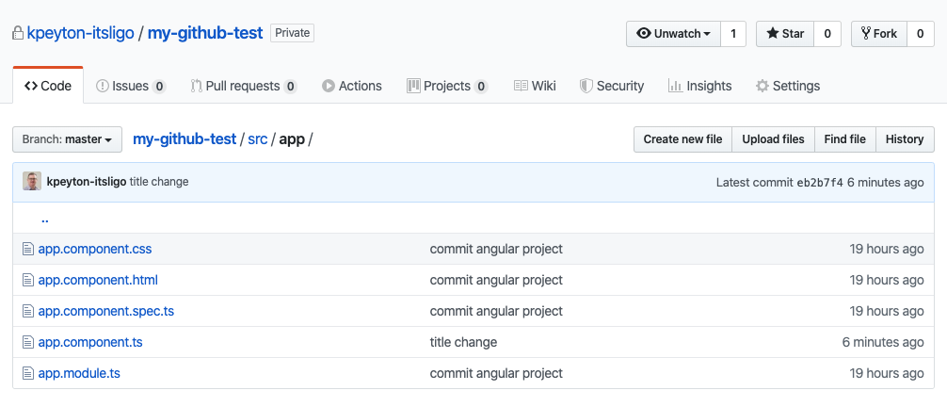
And commit message changes for that file

Slide 20
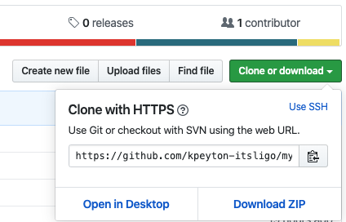
Download (Clone) Your Project
Copy the HTTPS link

Slide 21

Git Clone
I
n Windows in any folder open Git Bash
Command is git clone <string from GitHub project>

Slide 22
node_modules are missing. Why?
On purpose node_modules is not stored in GitHub, so after cloning from GitHub run npm install to get the node_modules from npm

